Slide 1
T1A3 TERMINAL APPLICATION
Valentinas Kornijenka

Slide 2
FEATURES
Feature 1: Generation of a workout schedule based on days and goal​
Feature 2: Ability to customize workouts by adding, swapping and deleting exercises​Areas of growth
Feature 3: Ability to export workout to a text file

Slide 3
FEATURE 1: KEY CODE OVERVIEW
Generation of a workout schedule based on days and goal
(workout_generator.py)

Slide 4
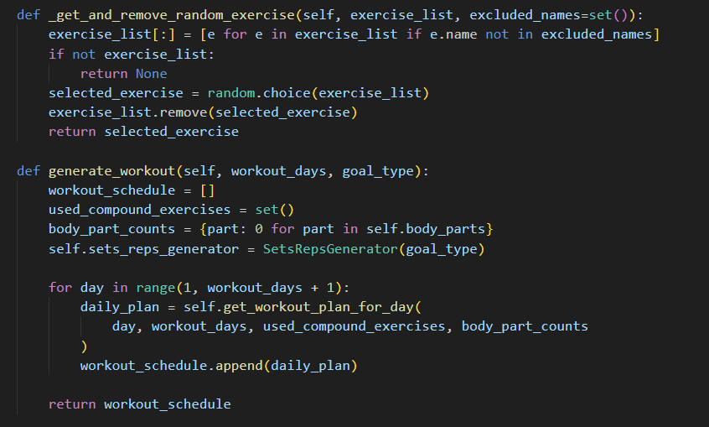
Gets workout from pseudo database and removes it to get rid of repetition
The user is asked for their goal type and how many days they would like to workout.
Then, they get a workout plan provided to them.
They also get a menu to either use the app further or exit.
Initializing an empty list for the workout schedule.
Creating a set to track used compound exercises to ensure no repetition..
Creating a set to track used compound exercises to ensure no repetition..
Initializing the sets and reps generator with the specified goal type.
Iterating over each day to generate a workout plan.

Slide 5
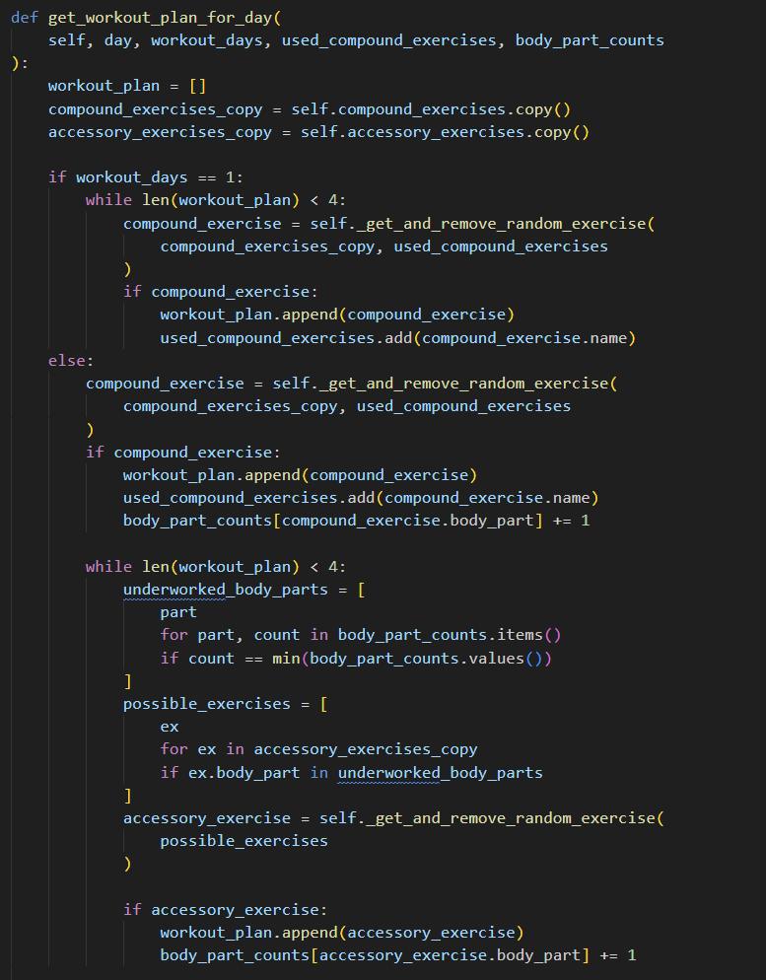
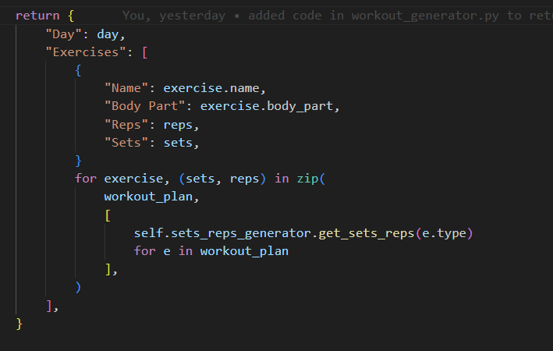
Initializing an empty list for the workout plan for the day..
If there's only one workout day, select up to 4 compound exercises.
The user is asked for their goal type and how many days they would like to workout.
Then, they get a workout plan provided to them.
They also get a menu to either use the app further or exit.
Keep adding exercises to the workout plan until it has 4 exercises
Return plan in dictionary format
Find body parts that have been worked the least.
Filter accessory exercises based on underworked body parts.
.
Select a random exercise from the possible exercises..

Slide 6
FEATURE 2: KEY CODE OVERVIEW
Ability to customize workouts by adding, swapping and deleting exercises
(workout_displayer.py)

Slide 7
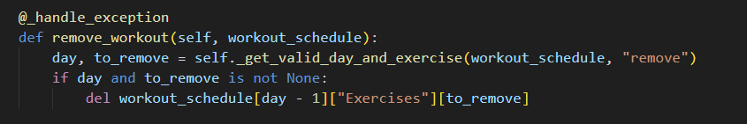
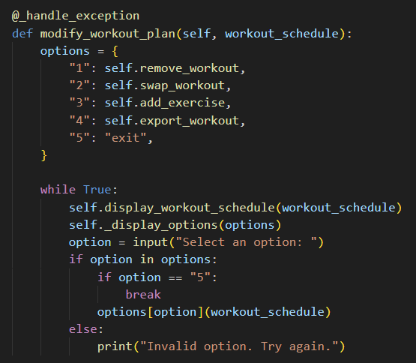
Method to remove function based on user input.
The user is asked for their goal type and how many days they would like to workout.
Then, they get a workout plan provided to them.
They also get a menu to either use the app further or exit.
Method to modify the workout plan.
Dictionary to hold the user option menu
Infinite loop to offer the user option menu
Displaying the current workout schedule.
Taking user input for selected option.
Checking for valid inputs
Checking if user wants to exit application

Slide 8
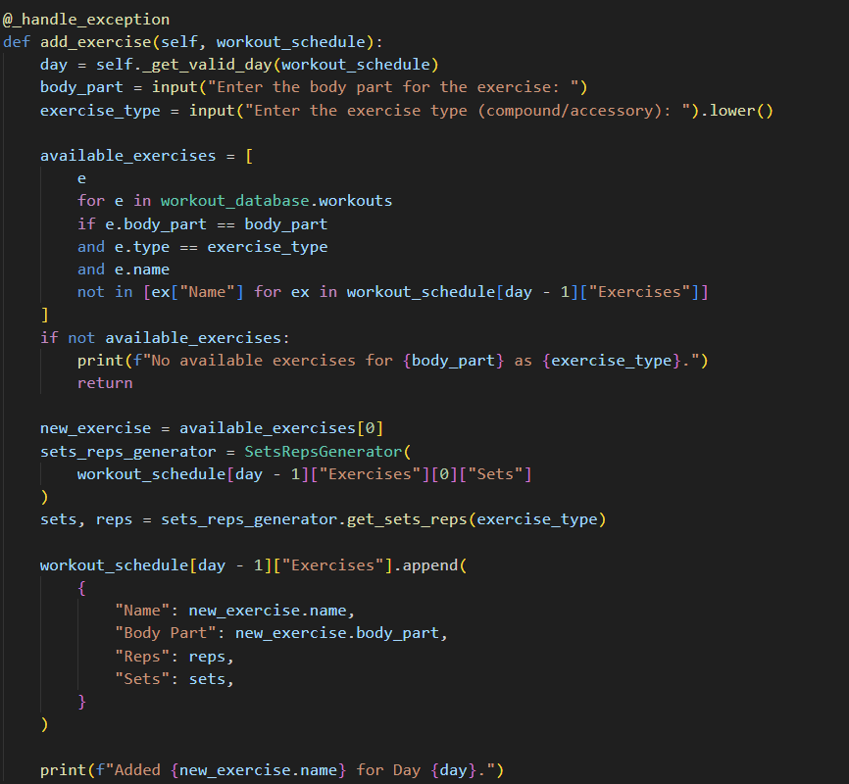
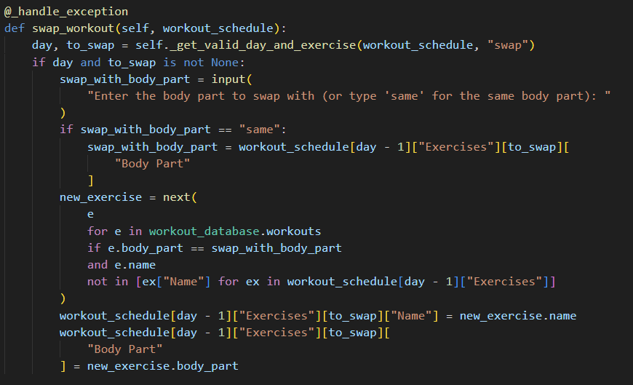
Method to add exercise
Use can choose between body part to work and if they want a compound or accessory movement
Finds exercise based on a filter
The user is asked for their goal type and how many days they would like to workout.
Then, they get a workout plan provided to them.
They also get a menu to either use the app further or exit.
If not available prints a message and returns.
Method to swap exercises.
Method to swap exercises.
User can either choose to have the same body part as they’re replacing or one of their choice.
Appends exercise to schedule.
Finds new exercise in pseudo database and if it’s new it swaps it.

Slide 9
FEATURE 3: KEY CODE OVERVIEW
Ability to export workout to a text file
(workout_displayer.py & workout_exporter.py)

Slide 10
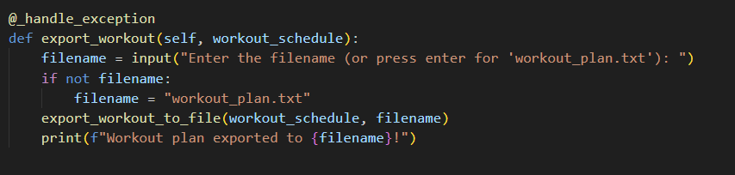
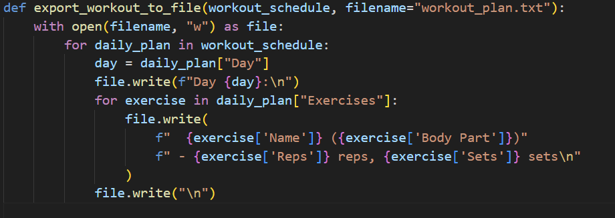
Method to export workout.
User can enter file name or choose default name.
Confirmation message.
The user is asked for their goal type and how many days they would like to workout.
Then, they get a workout plan provided to them.
They also get a menu to either use the app further or exit.
Exports workout onto a text file.
Formats document in an easy to read method.

Slide 11
APP USAGE EXAMPLE

Slide 12
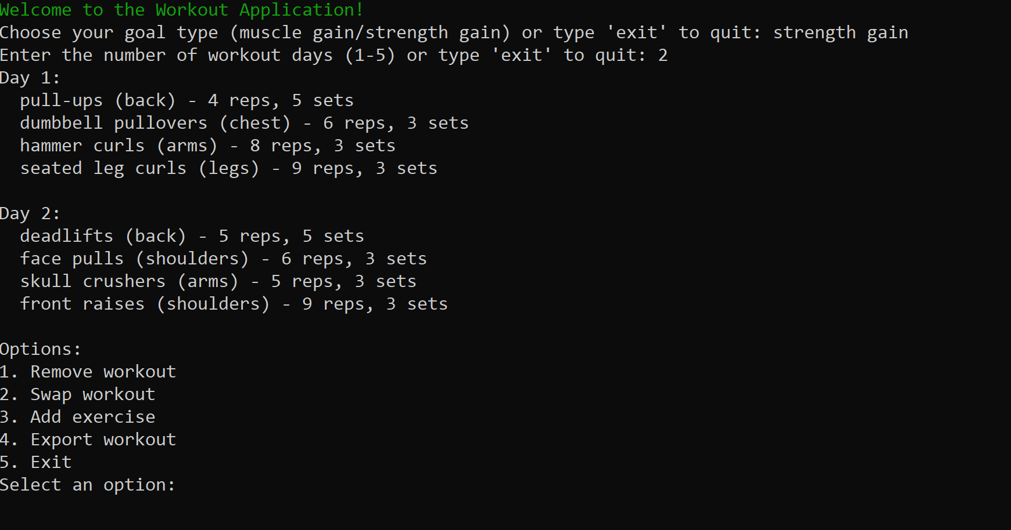
The user is asked for their goal type and how many days they would like to workout.
Then, they get a workout plan provided to them.
They also get a menu to either use the app further or exit.

Slide 13
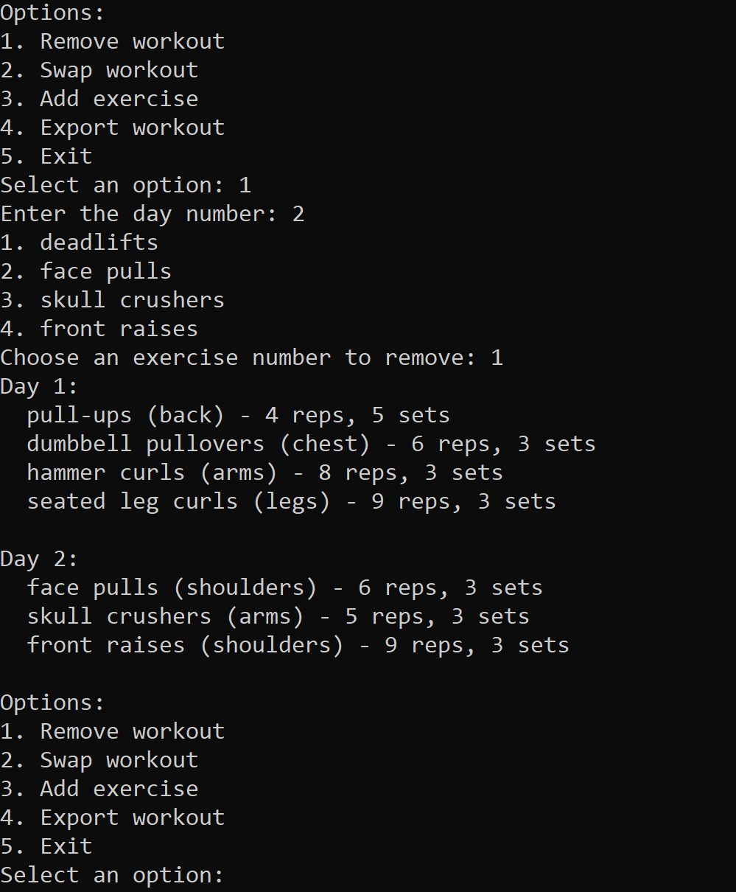
The user gets several options to manipulate the provided workout plan.
In this example, the user removed the deadlifts from Day 2.
The user also has options to swap, add and export workouts.

Slide 14
What I enjoyed & challenges
It was really fun to challenge myself!
I learnt so much about Python doing this
Using Trello for project management was really useful and I will definitely use it more in the future.
I did found the project to be very challenging.
In retrospective, I should have considered a minimum viable product more as my code ended up being very complex.
I used OOP which potentially may have made writing code more difficult for my skill level.

Slide 15
THANK YOU

